Slide 1

Farm Monitor Product Design Practice INT303
Jan-Apr 2022, 6th Semester
Group B2-29.
KM Himanshu – CED19I026.
Swapnil Paranjape – MFD19I003.
Atharva Baste – MSM19B024.

Slide 2
Introduction –
Farming is the backbone of our economy. Farms are fragile ecosystems. A lot of external and environmental factors can affect the potential yield of a farm in a negative way. Sub-optimal irrigation patterns and a lack of real-time farm information results in a major reduction of crop productivity.

Slide 3
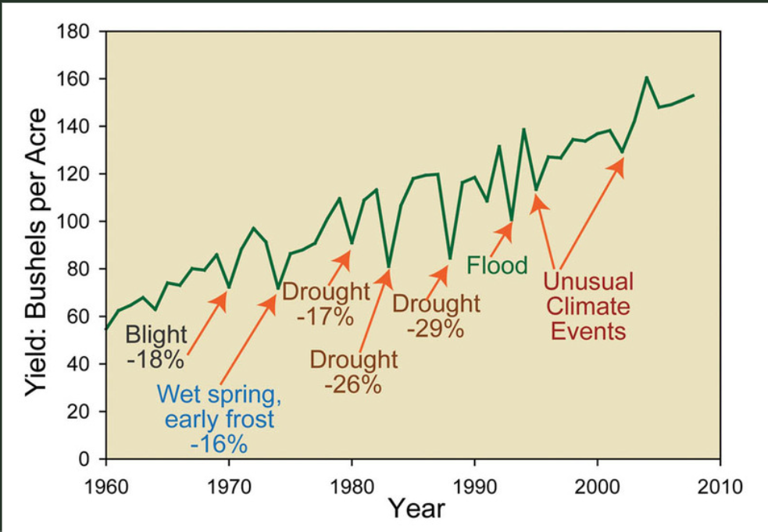
Current Scenario
We can see in the graph above that agriculture in India remains heavily dependent on annual rainfall. We are facing difficulties in the shortage of water resources, limited availability of land, difficult to manage the costs while meeting the demands of increasing consumption needs of a global population that is expected to grow by 70% by the year 2050. The influence of population growth on agriculture leads to a miserable impact on the farmers livelihood.
To overcome the problems our aim is to design a low cost system for monitoring the agriculture in the farm which continuously measures the level of vital inputs to the plants and alert the farmers if the content of the inputs to the particular plants falls below/above the threshold.

Slide 4
Road Map –
Feb 14-Research on Automation of irrigation(via switch)
Feb 22-Component procurement(all by Feb 22)
Feb end-Complete simulation of sensors(virtual)
Testing bought sensors(physical)
March 15-ESP8266 module integration
March 22-Backend development & Frontend Development
March end-Assembly of parts of product
April Week 2-Integration of backend with frontend,
April Week 3-Final testing
April end-Project complete

Slide 5
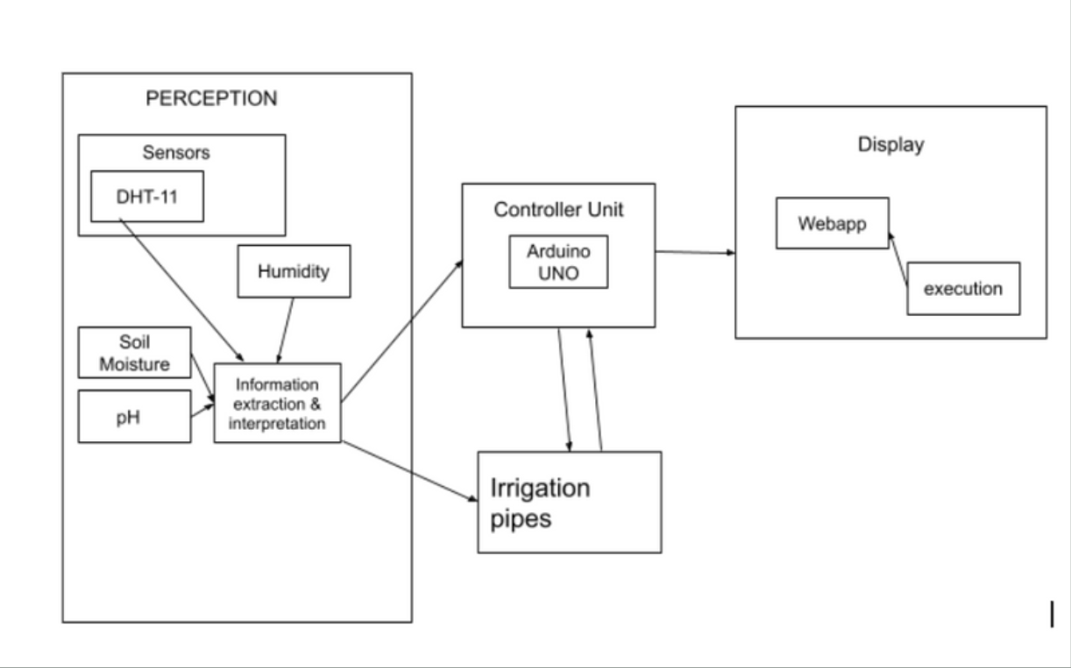
Methodology and Working Principle–
The device, using an array of sensors, collects information about the environmental factors and soil conditions.
The DHT-11 sensor collects data about the air temperature and humidity and the soil moisture sensor using the principle of capacitance collects information about the moisture content in the soil.
All the data that is collected is then sent for information extraction and interpretation. This is achieved by sending the data to an Arduino/nodeMCU microcontroller, which then checks the data and automates the irrigation process to achieve optimal irrigation to ultimately boost agricultural yield. The nodeMCU Wi-Fi module which is inbuilt the nodeMCU-ESP8266 is then used to send the data collected from the sensors to our live database where it is analyzed and meaningful insights are drawn.
These insights are then sent to our application where it will be displayed and conveyed to our customer in a very user-friendly way. Farm monitor will also suggest practices based on the data to further help increase the output. Farm monitor will thus help bring some consistency to farming.

Slide 6
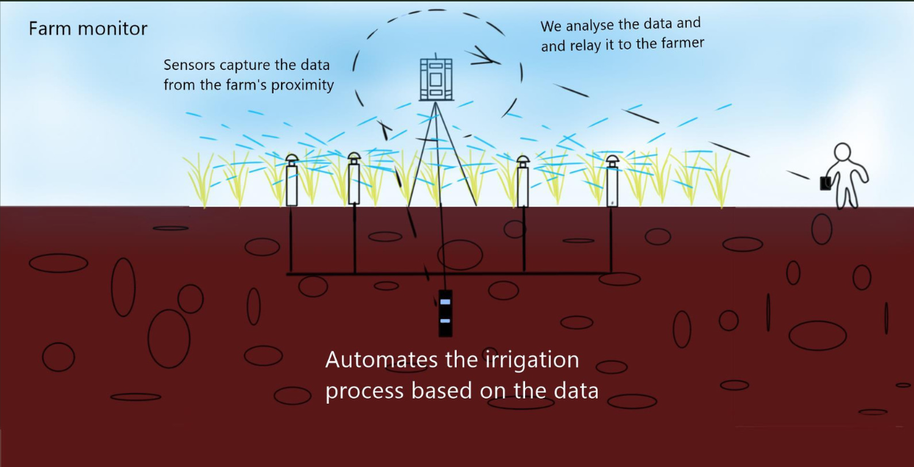
Rough Sketch –

Slide 7
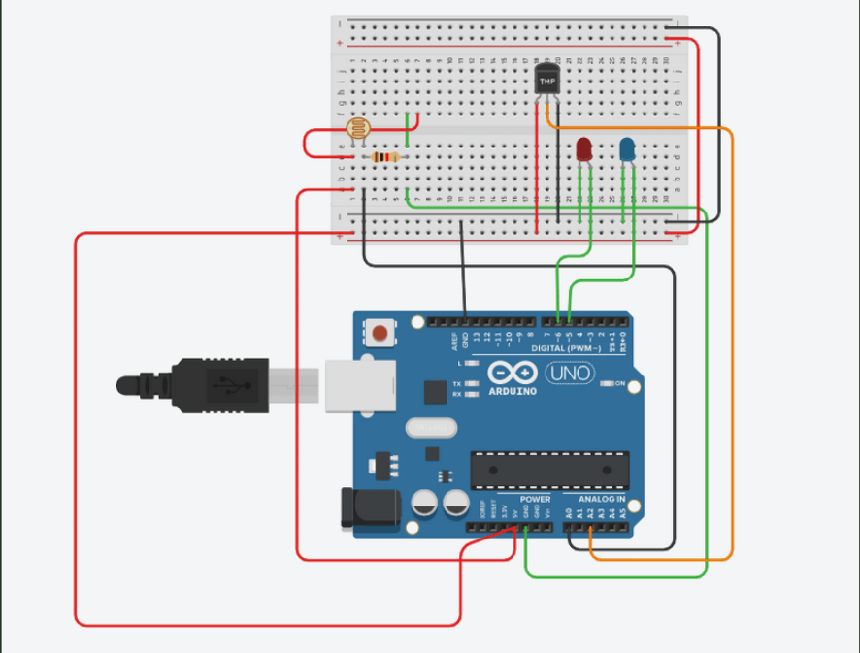
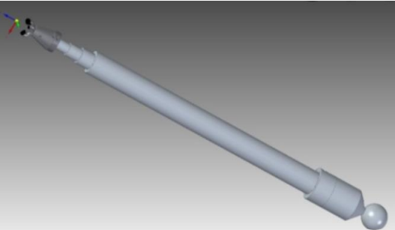
Simulation in Tinker-Cad and Cad Model –

Slide 8
Literature –
Automated Irrigation System Using a Wireless Sensor Network and GPRS Module
An IoT based soil moisture monitoring on Losant platform
Soil moisture monitoring using IoT enabled arduino sensors with neural networks for improving soil management for farmers and predict seasonal rainfall for planning future harvest in North Karnataka — India

Slide 9
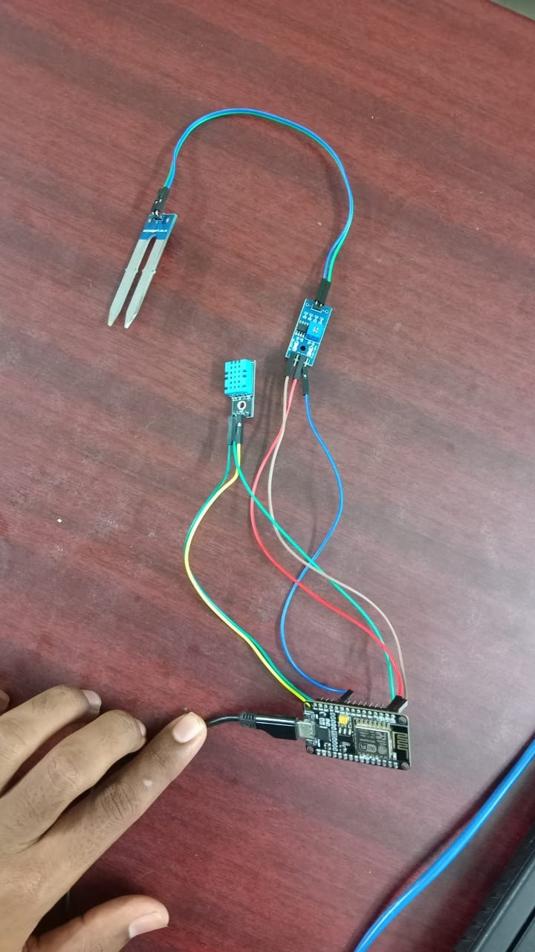
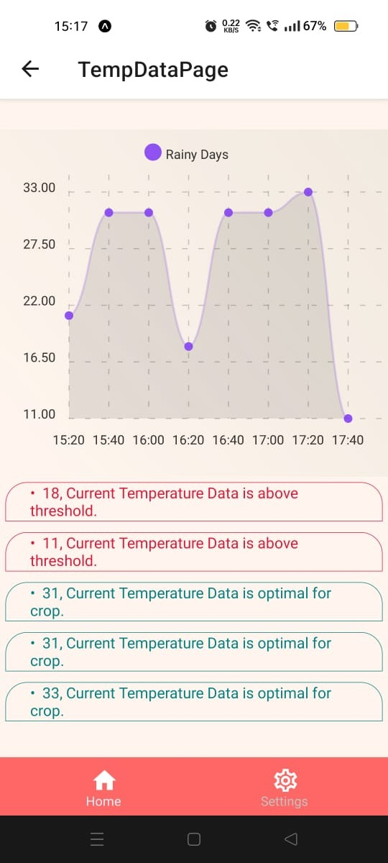
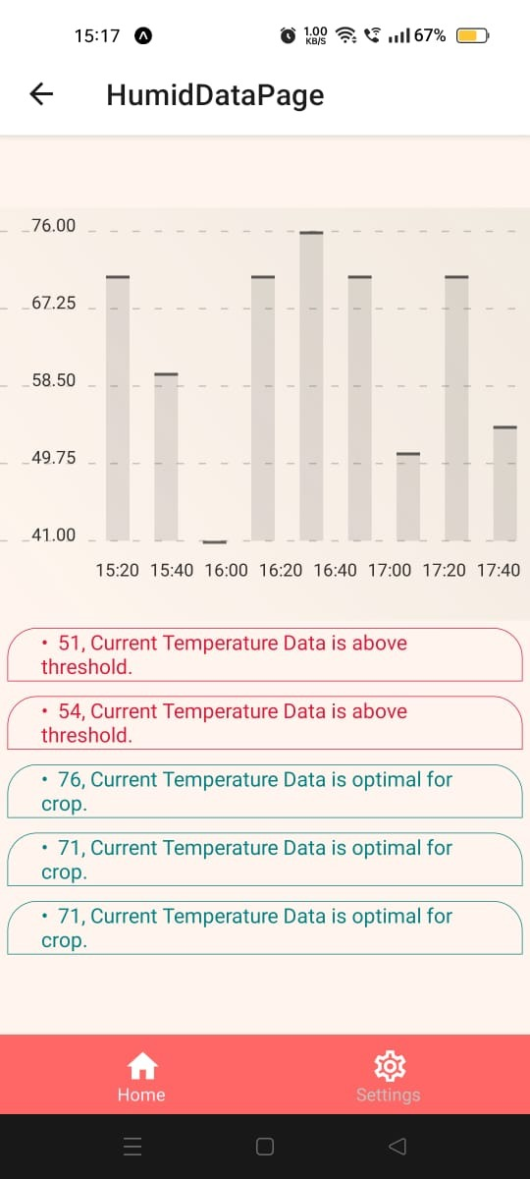
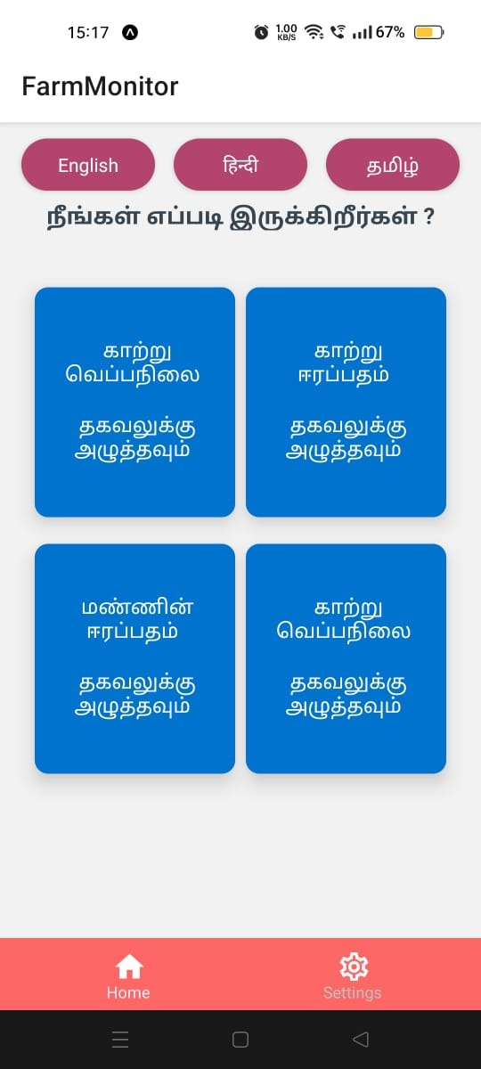
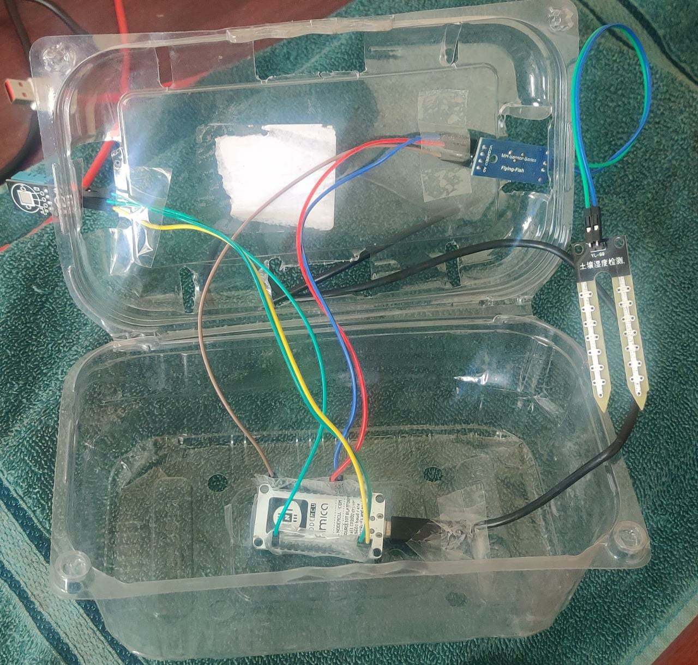
Results(Graphs/Pictures/Screenshots)

Slide 10
Future Enhancements –
We can extend this solution to also check for content of minerals in the soil, thus helping better monitor and control the growth of crops.
We can use ML algorithms to further improve the analysis provided from the data gathered from sensors.
Alert farmers through use of SMS or Radio incase of network coverage issues

